Slide 1
Risk factors discovery and predictive modelling
Daniel Szponar, Warsaw 4.2021

Slide 2

Presentation plan
Task goals
Data
Findings
Modelling
Data Science framework

Slide 3
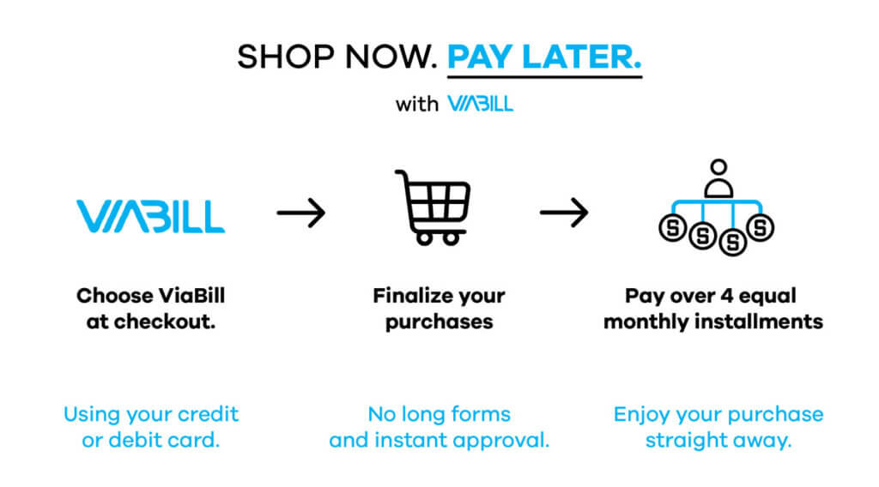
Task goals
identify factors which may be used to predict which customers will pay late,
identify factors which may be used to predict which customers will not pay an instalment at all (default),
build predictive model that will predict if client pays back the loan or not,

Slide 4
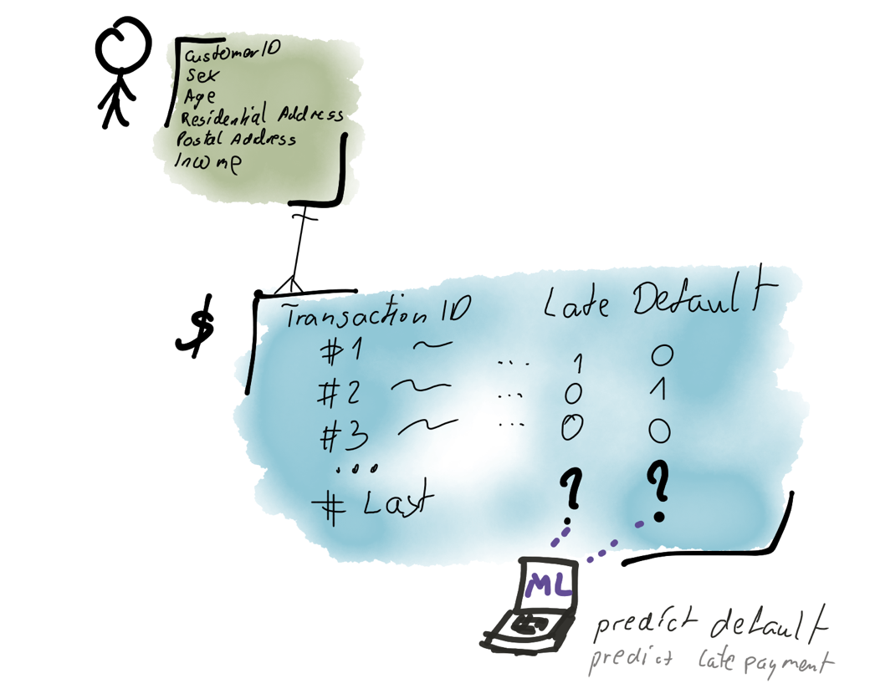
Data
overview
Customers table ~ 500K
Transactions ~ 2 MLN

Slide 5
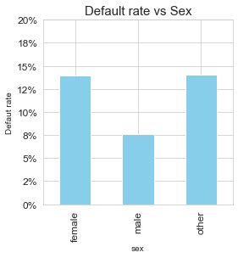
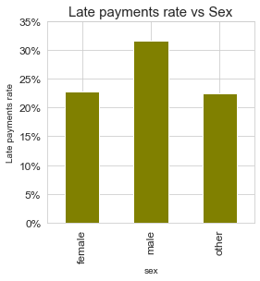
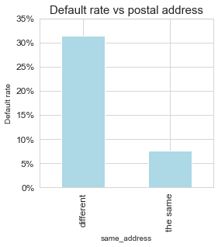
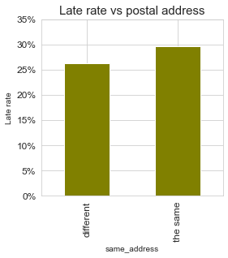

Findings
sex, postal address
Females/other are almost twice likely to default then man,
males are 50% more likely to be late with payments,
if postal address isn't the same as residential address, then customer is 4 times more likely to default, and 15% more likely to be late with payment (killer feature),

Slide 6
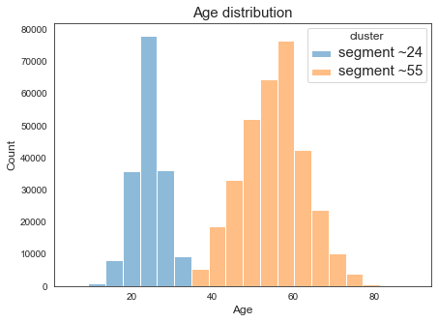
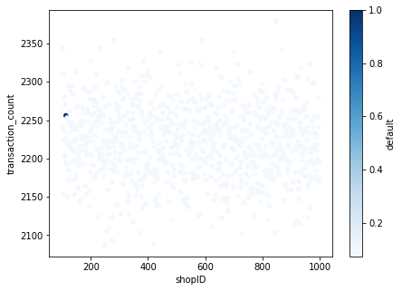

Findings
age, fraudulent shop
There are two customer segments given age, that can be easily separated using GaussianMixture,
Each transaction in Shop (ID 113) is ended with default (a fraud),

Slide 7

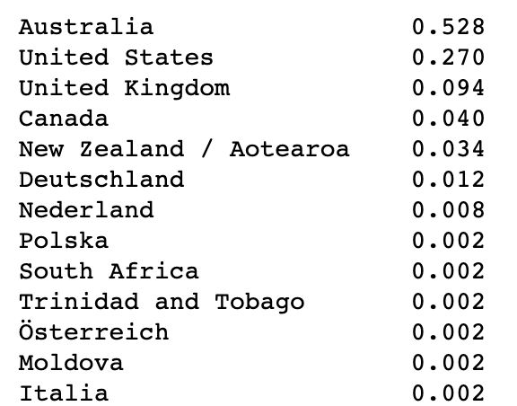
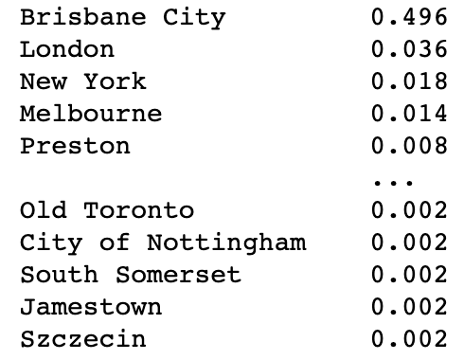
Findings
Geodata
Most of the customers are (probably) from Brisbane, Australia,
The World Turns

Slide 8
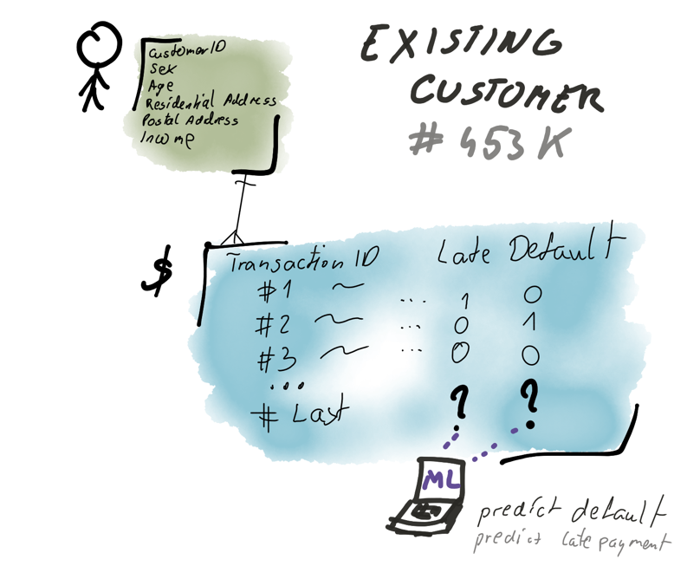
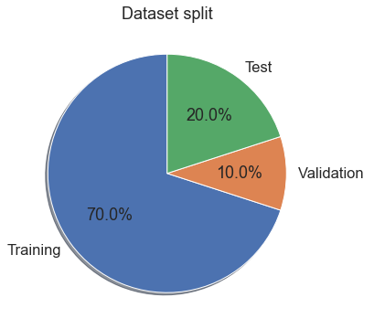
Modelling
Data split
There are around 450K of observations in the segment “Existing Customer”
train - dataset for model training,
test - dataset for model performance assessing (out of sample),
valid - dataset for hp tuning (out of sample),
* I omit New Customer segment in modelling, it deserve to have separate model,

Slide 9
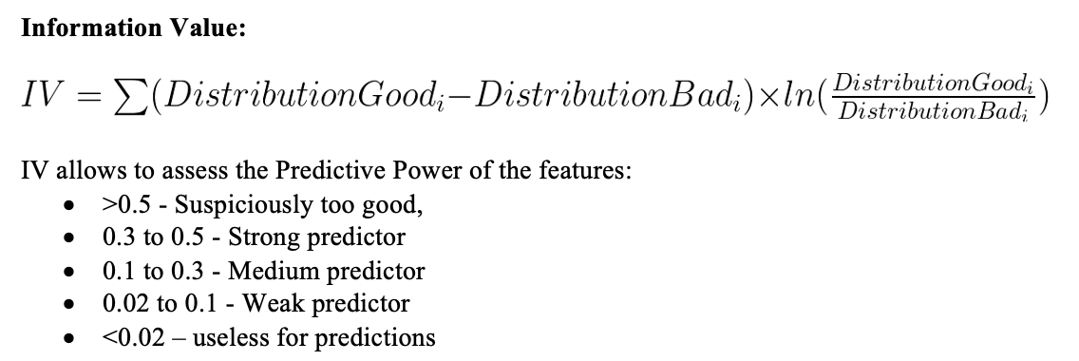
Modelling
One dimensional analysis
The most predictive numerical features for default:
same address: IV 0.32 [Strong],
sex: IV 0.098 [Medium predictor],
default_lst_06_avg – IV 0.234 [Medium predictor],
defualted_payment_lst_06_avg – IV 0.225 [Medium predictor],
money_lost_lst_06_avg – IV 0.212 [Medium predictor],
The most predictive numerical features for late payment:
late_lst_06_avg – IV 0.163 [Medium predictor],
late_payment_first_lst_03_avg – IV 0.212 [Medium predictor],

Slide 10
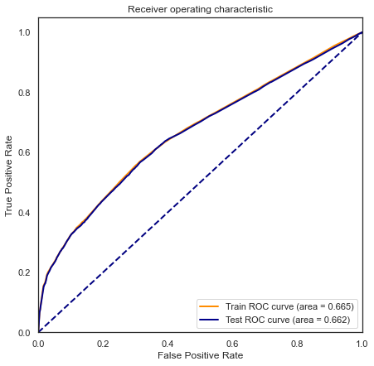
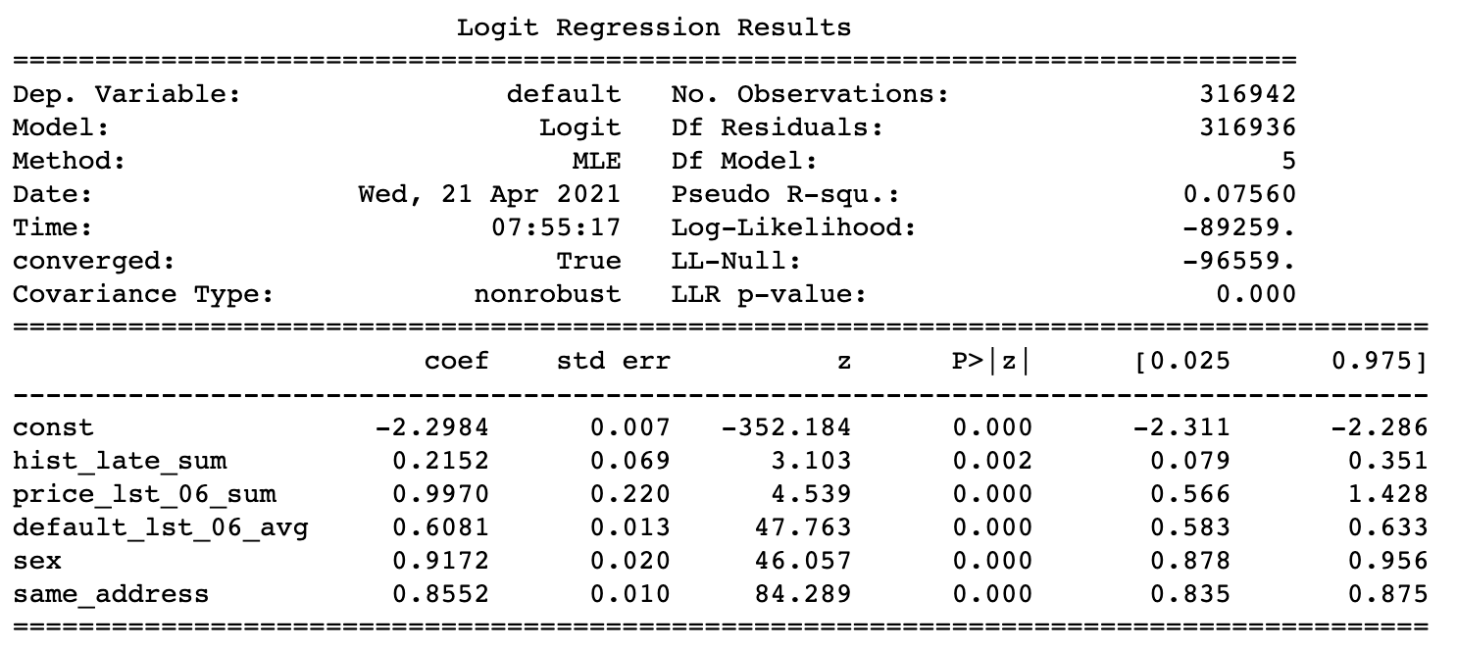
Modelling
Logistic Regression
# | Model name | AUC – train | AUC – test
1 | Logistic Regression | 0.665 (GINI 33) | 0.662 (GINI 33)
Logistic Regressions coefficients
ROC curve
hist_late_sum – number of late paid transaction, so far,
price_lst_06_sum – the sum of item purchased, in the past 6 transaction window,
default_lst_XX_avg – default rate on client, in the past 6 transaction window,
sex
same address

Slide 11
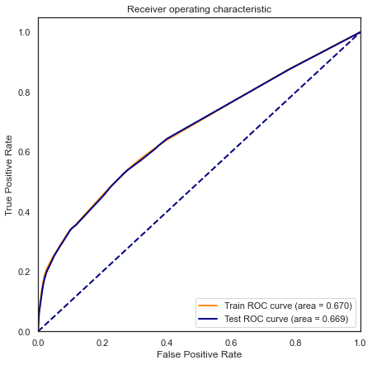
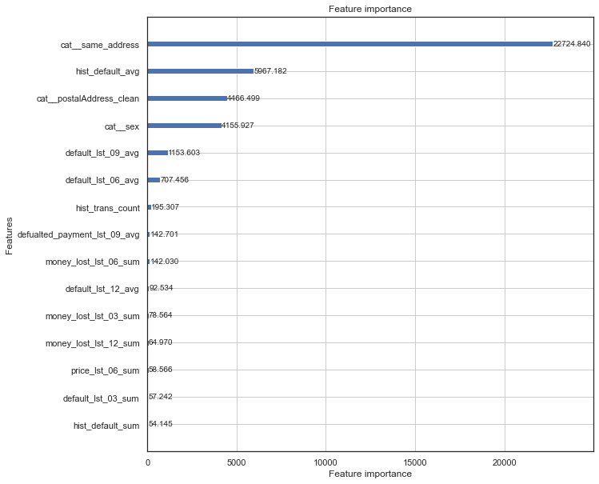
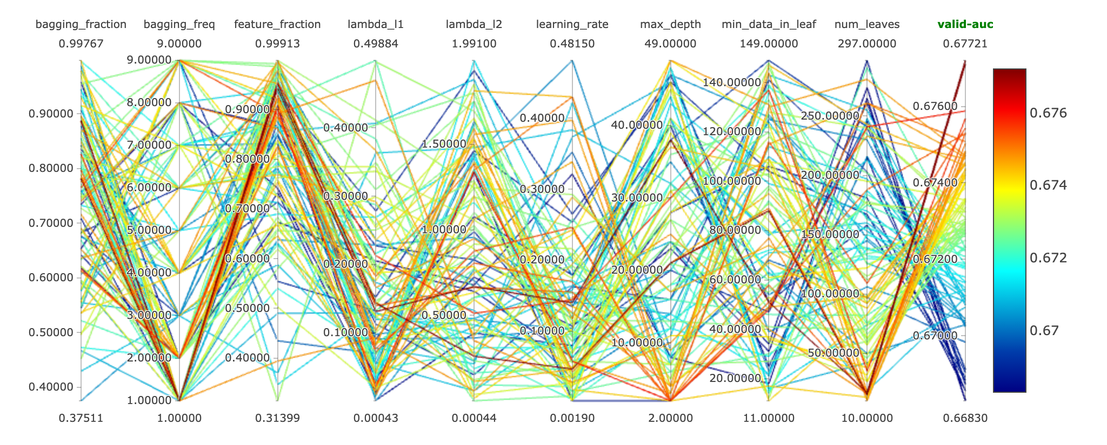
Modelling
LightGBM
# | Model name | AUC – train | AUC – test
2 | LightGBM + HyperOpt | 0.67 (GINI 34) | 0.669 (GINI 34)
ROC curve
Hyperparameter tunig
Features importance - gain

Slide 12
Modelling
# | Model name | AUC – train | AUC – test | Notes
1 | Logistic Regression with SFFS | 0.665 | 0.662 | + results easy to interpret + feature importance + easy to deploy and use - -need some improvements, it takes a lot of time and knowledge to build a good model due to the need to meet statistical assumptions,
3 | LightGbm + Hyperopt | 0.67 | 0.669 | + very fast to build, no need to worries about outliers, missing values, values normalization, + non-parametric model with no statistical assumption, - black box – difficulties in interpreting factors that affect results, - more difficult to deploy without Docker,

Slide 13
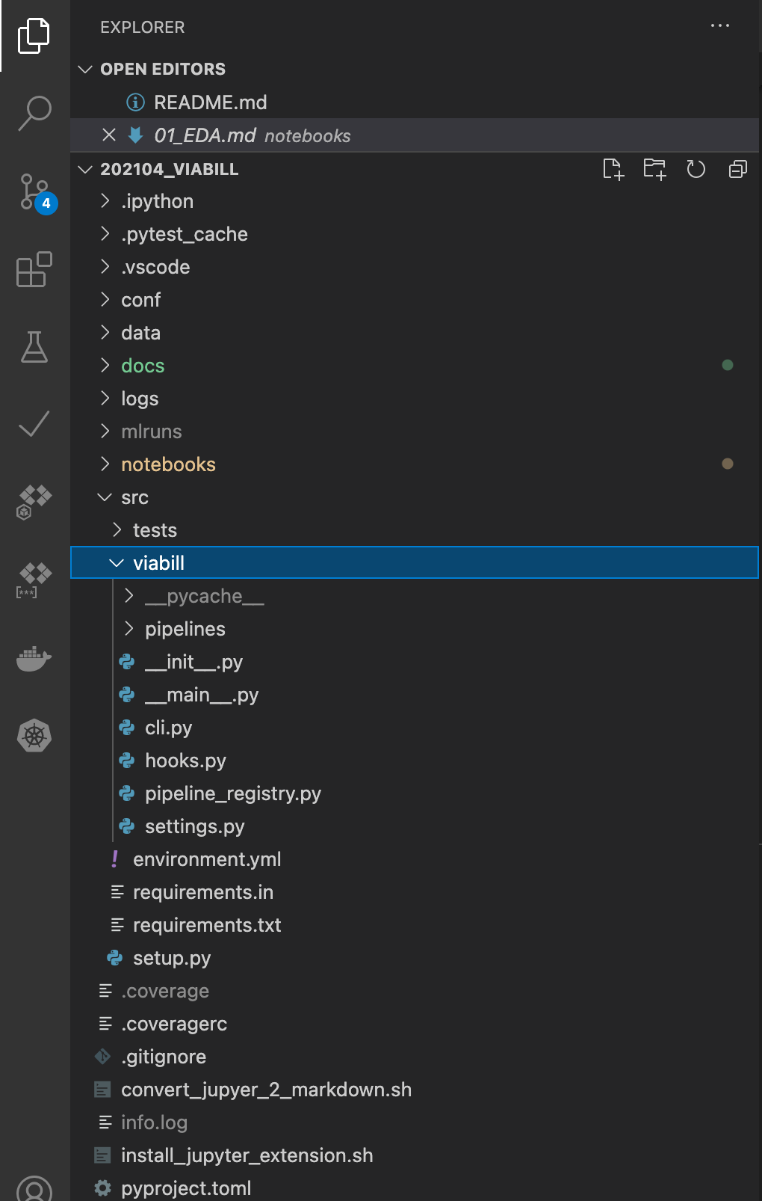
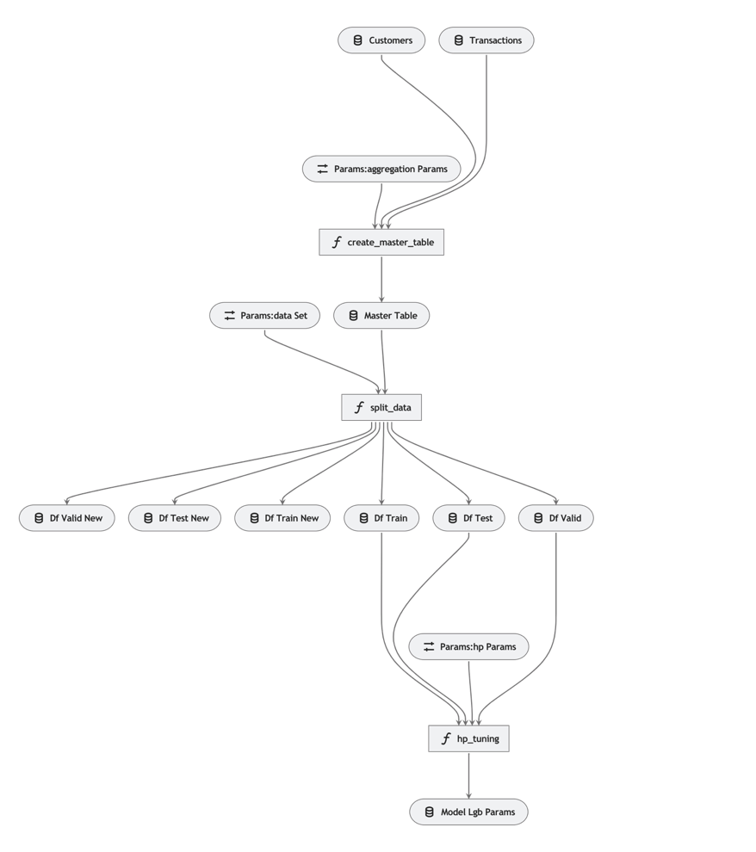
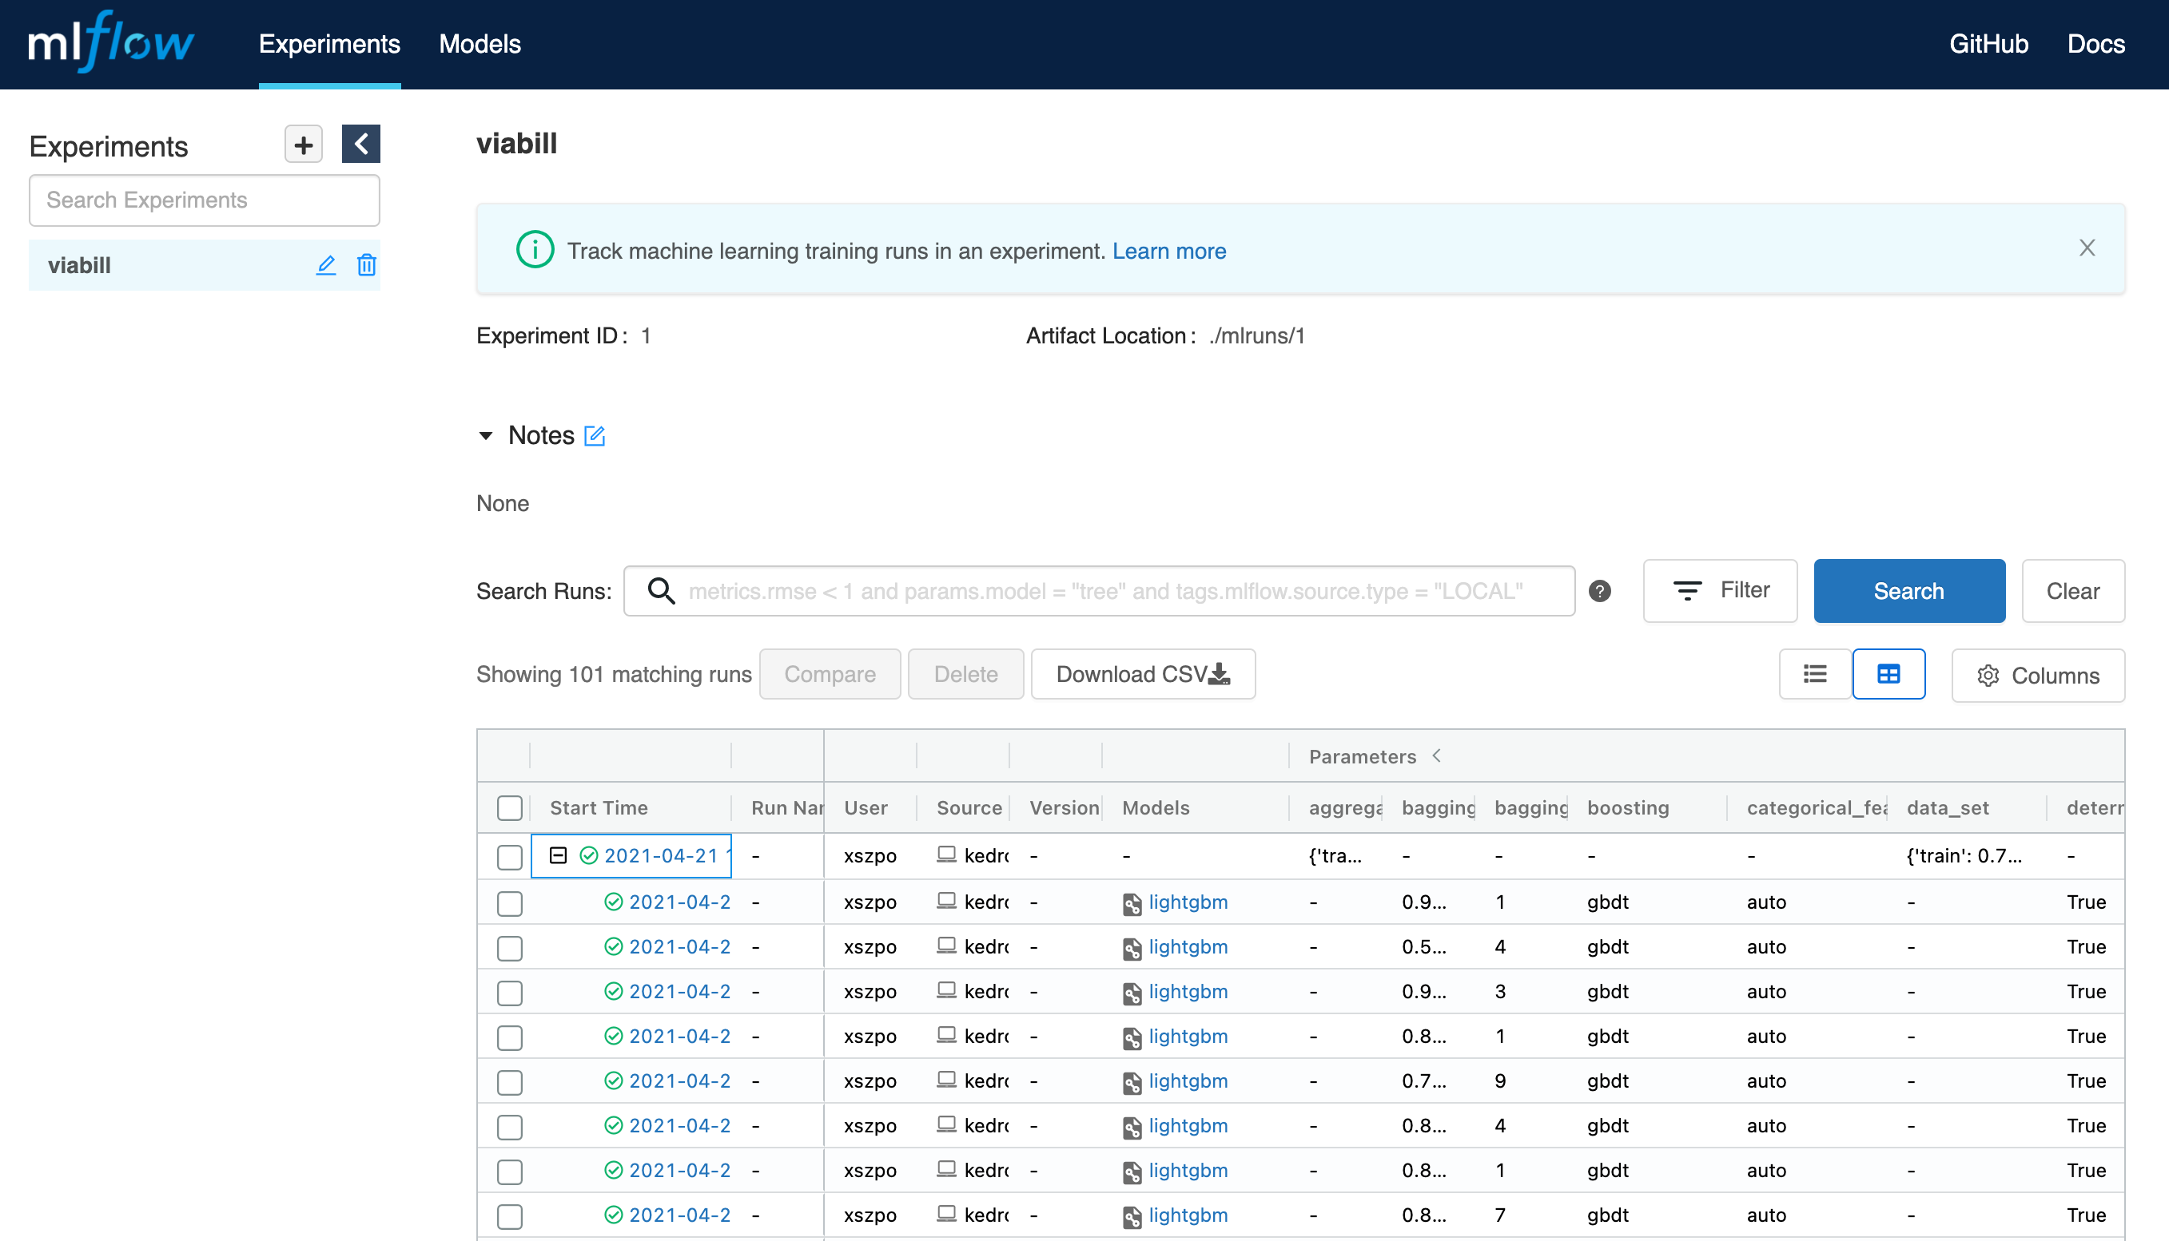
Data Science Framework
Kedro, MlFlow, Conda
Project structure and consistent Data Science framework,
KEDRO PROJECT
Data Transformations and Data Catalog
KEDRO PIPELINES
Experiment tracking and model registry
MLFLOW TRACKING

Slide 14
Tak for din opmærksomhed
Thank you for attention
Dziękuję za uwagę
https://github.com/xszpoassignments/vb
https://github.com/xSzpo

